Slide 1
Murach’s Modern JavaScript
Chapter 7
How to test and debug an app

Slide 2
Objectives
Applied
Develop a test plan for an app.
Use Chrome’s developer tools to debug an app by setting breakpoints, viewing the current data values, and stepping through the execution of statements.
Trace the execution of an app by using methods of the console object.
View the HTML and CSS for a web page.
Knowledge
Distinguish between testing and debugging.
Distinguish between syntax, runtime, and logic errors.
Describe the debugging problem that can occur if you don’t use strict mode and JavaScript treats undeclared variables as global variables.

Slide 3
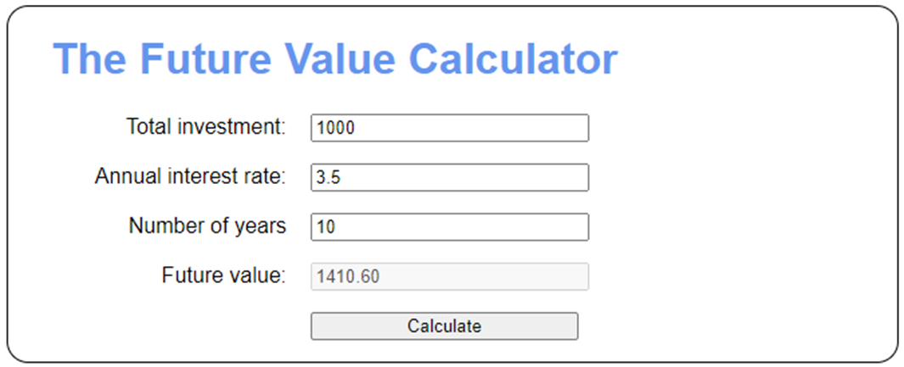
The Future Value app

Slide 4
The HTML for the <body> element (part 1)
<body>
<h1>The Future Value Calculator</h1>
<div>
<label for="investment">Total investment:</label>
<input type="text" id="investment">
</div>
<div>
<label for="rate">Annual interest rate:</label>
<input type="text" id="rate">
</div>
<div>
<label for="years">Number of years</label>
<input type="text" id="years">
</div>
<div>
<label>Future value:</label>
<input type="text" id="future_value" disabled>
</div>

Slide 5
The HTML for the <body> element (part 2)
<div>
<label>&nbsp;</label>
<input type="button" id="calculate"
value="Calculate">
</div>
<script src="future_value.js"></script>
</body>

Slide 6
The CSS for the <label> and <input> elements
label {
display: inline-block;
width: 11em;
text-align: right;
}
input {
width: 15em;
margin-left: 1em;
}

Slide 7
The JavaScript for the Future Value app (part 1)
function getElement(selector) {
return document.querySelector(selector);
}
function isNotValid(val) {
return isNan(val) || val <= 0;
}
function calcFutureValue(investment, rate, years) {
let futureValue = investment;
for (let i = 1; i <= years; i++) {
futureValue += futureValue * rate / 100;
}
return futureValue;
}

Slide 8
The JavaScript for the Future Value app (part 2)
function calcButtonClick() {
// clear any previous calculation
getElement("#future_value").value = "";
// get values user entered in textboxes
const investment =
parseFloat(getElement("#investment").value);
const rate = parseFloat(getElement("#rate").value);
const years = parseInt(getElement("#years").value);
// check user entries and set error message
let errorMsg = "";
if (isNotValid(investment)) {
errorMsg +=
"Investment amount must be a positive number.\n";
getElement("#investment").focus();
}

Slide 9
The JavaScript for the Future Value app (part 3)
if (isNotValid(rate)) {
errorMsg +=
"Interest rate must be a positive number.\n";
getElement("#rate").focus();
}
if (isNotValid(years)) {
errorMsg +=
"Number of years must be a positive number.";
getElement("#years").focus();
}
// if valid user entries, calc and display future value
if (errorMsg == "") {
const futureValue =
calcFutureValue(investment, rate, years);
getElement("#future_value").value =
futureValue.toFixed(2);
} else {
alert(errorMsg);
}
}

Slide 10
The JavaScript for the Future Value app (part 4)
document.addEventListener("DOMContentLoaded", () => {
// attach the click event handler for the button
getElement("#calculate").addEventListener("click",
calcButtonClick);
// set focus on first text box on initial load
getElement("#investment").focus();
});

Slide 11
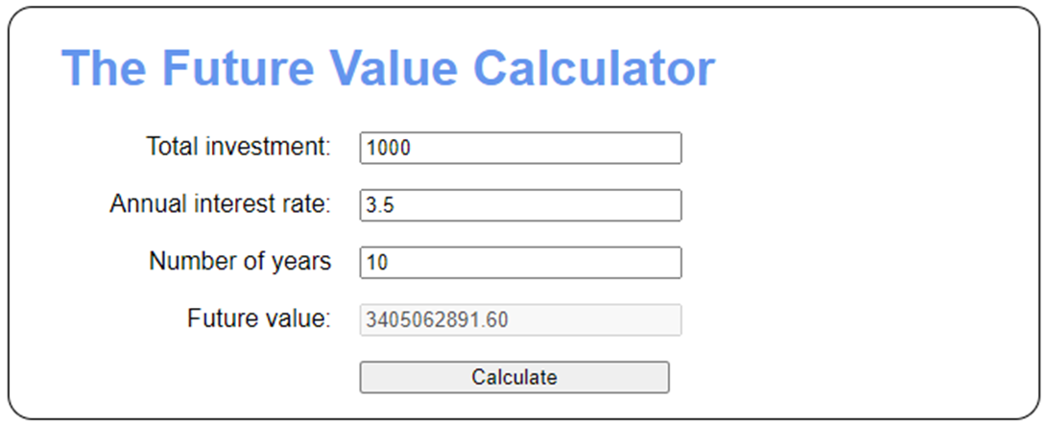
The Future Value app with a logic error

Slide 12
The goal of testing
To find all errors before the app is put into production.
The goal of debugging
To fix all errors before the app is put into production.
The three types of errors that can occur
Syntax errors violate the rules for how JavaScript statements must be written. These errors are caught by the JavaScript engine when the browser loads the JavaScript for a page.
Runtime errors occur after a page is loaded and the app is running. When the JavaScript engine encounters a statement that it can’t execute, it throws an error that stops the execution of the app.
Logic errors are errors in the logic of your code. They don’t stop the execution of the app, but they produce the wrong results.

Slide 13
Common syntax errors
Misspelled names.
Incorrect case for names.
Omission of required parentheses, quotation marks, or braces.
Use of the assignment operator (=) instead of the equality (==) or strict equality (===) operator to test for equality.
A problem with HTML references
Incorrect reference to an HTML component.

Slide 14
Problems with data types
Not making sure that a user entry is the right data type before processing it.
Not converting a user entry to a numeric value before using it in arithmetic operations.

Slide 15
A problem you can avoid by using strict mode
If you don’t use strict mode and you assign a value to a variable that hasn’t been declared, the JavaScript engine treats it as a global variable, as in this example:
function calculateTax(subtotal, taxRate) {
let salesTax = // salesTax is local
subtotal * taxRate;
salestax = // salestax is global
Number(salesTax.toFixed(2));
return salesTax; // salesTax isn't rounded
// but salestax is
}

Slide 16
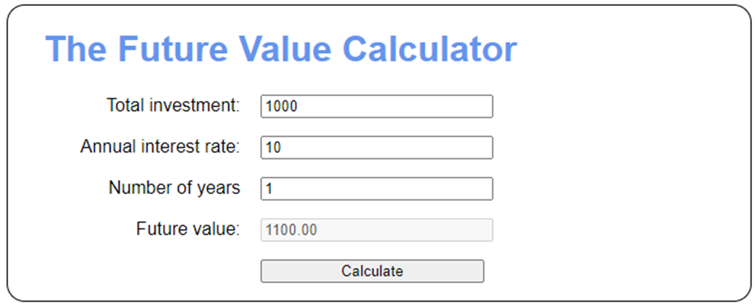
The Future Value app with valid data

Slide 17
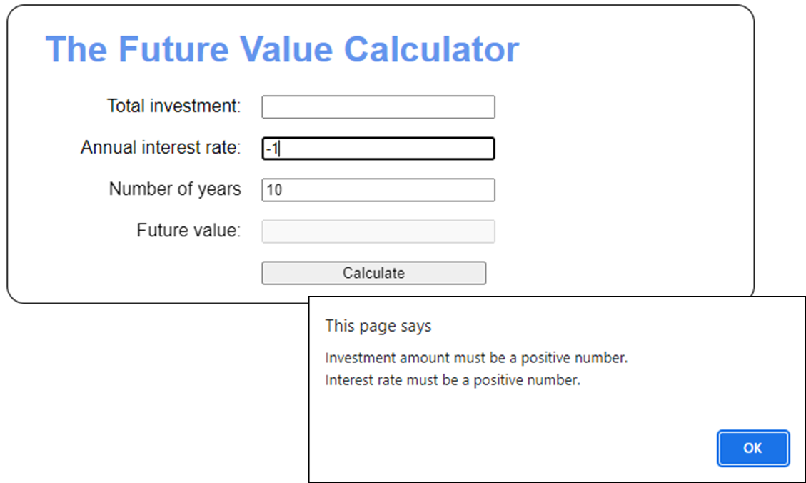
The Future Value app with invalid data

Slide 18
The two test phases
Test the app with valid input to make sure the results are correct.
Test the app with invalid input and unexpected user actions.
How to make a test plan
List the valid entries that you’re going to make and the correct results for each set of entries. Then, make sure that the results are correct when you test with these entries.
List the invalid entries that you’re going to make. These should include entries that test the limits of the allowable values. Then, make sure your app handles these entries appropriately.
Two common testing problems
Not testing a wide enough range of entries.
Not knowing what the results of each set of entries should be and assuming that the results are correct.

Slide 19
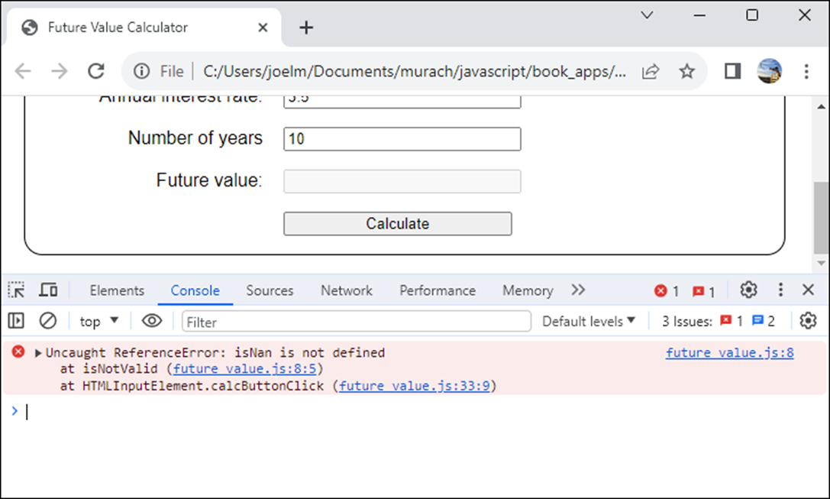
The Chrome Console panel with an error

Slide 20
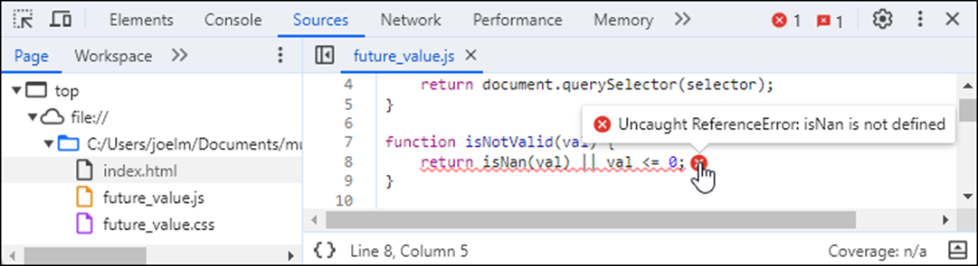
The Sources panel after the link in the Console panel has been clicked

Slide 21
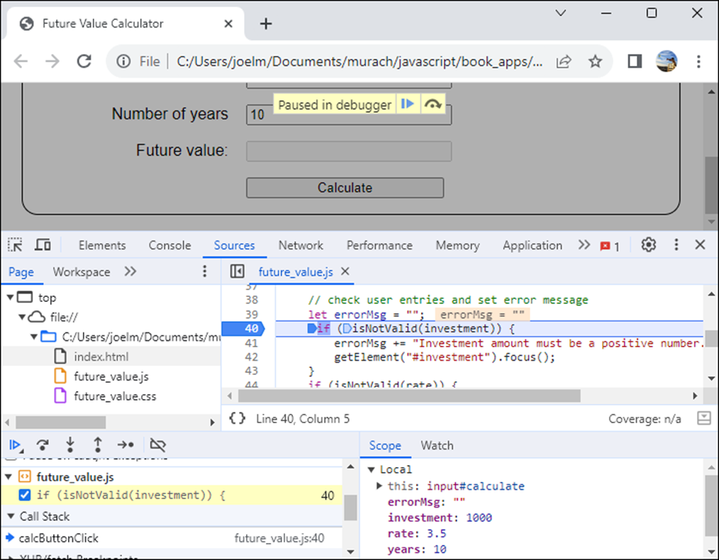
A breakpoint in the Sources panel

Slide 22
The buttons and keys for stepping through the JavaScript code
Button | Key
Step Into | F11
Step Over | F10
Step Out | Shift+F11
Resume | F8

Slide 23
How to view the current data values at each step
Hover the mouse pointer over a variable or constant name in the Code Editor pane.
View the current values in the Scope section of the Debugging pane.
In the Debugging pane, click the Watch tab. Then, in the Watch section, click the plus sign and type the variable name, constant name, or expression that you want to watch.
The values are also displayed to the right of the declarations in the Code Editor pane.

Slide 24
Code with two log() methods that trace its execution
function calcFutureValue(investment, rate, years) {
console.log("calcFutureValue() has started");
let futureValue = investment;
for (let i = 1; i < years; i++ ) {
futureValue += futureValue * rate / 100;
console.log(`year ${i} future value is ${futureValue}`);
}
return futureValue;
}

Slide 25
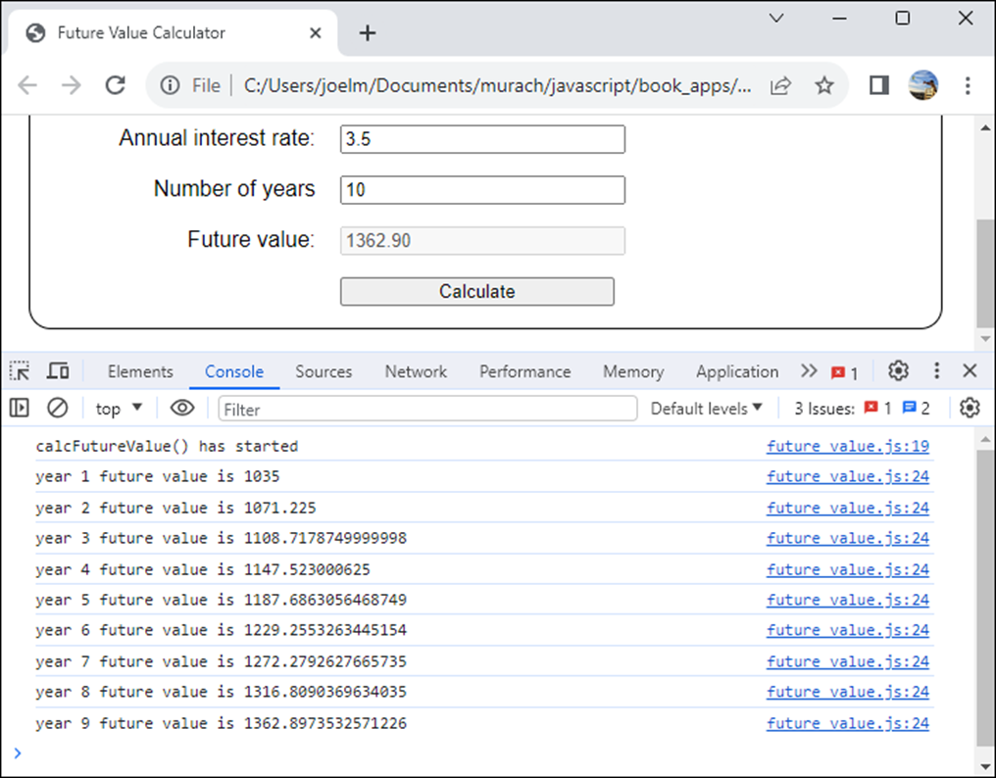
The messages in the Console panel

Slide 26
Three more methods of the console object
error(string)
warn(string)
trace()

Slide 27
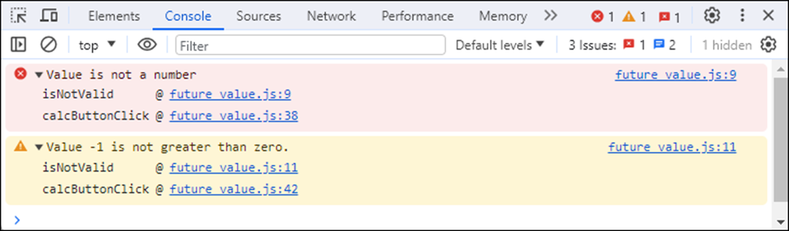
Code that sends an error or warning message to the Console panel
function isNotValid(val) {
if (isNaN(val)) {
console.error("Value is not a number");
} else if (val <= 0) {
console.warn(`Value ${val} is not greater than zero.`);
}
return isNaN(val) || val <= 0;
}
Messages after running the code twice with invalid data

Slide 28
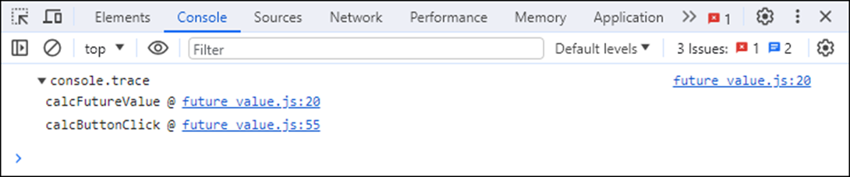
Code that sends a stack trace to the Console panel
function calcFutureValue(investment, rate, years) {
console.trace();
...
The stack trace in the Console panel

Slide 29
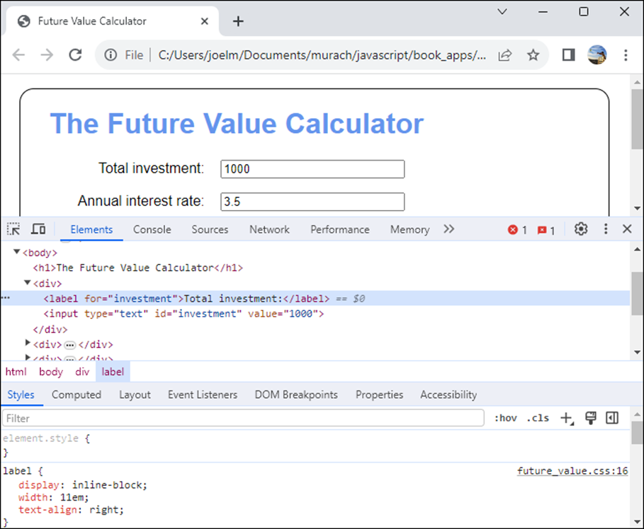
The HTML and CSS for a web page in the Elements panel

